Slide 1
Project presentation
Team Member:
Ishwar Dangi
Susmita Sapkota
Anusha Silwal
Ashrika Chaulagain

Slide 2
Thought behind developing unit conversion tool
The primary thought behind developing a unit conversion tool is to simplify and automate the process of converting measurements between different units. This tool aims to enhance accuracy, reduce manual errors, and save time by providing quick and reliable conversions. It caters to various needs across fields like science, engineering, and daily life, ensuring consistent and efficient handling of measurements.

Slide 3
Unit Converter Application
Objectives: Develop a user friendly unit conversion tool
We developed a GUI based unit conversion tool using Python and ‘Tkinter’.
‘Tkinter’ is a the standard Python library used for creating graphical user interfaces (GUIs). It is a simple and straightforward tool that allows us to create windows, buttons, text fields, and other GUI elements in Python applications.
Key features of our project:
Supports multiple categories: Weight, Length, Time, Temperature
Interactive GUI with Tkinter
Real-time conversion with error handling

Slide 4

Import statement for using tkinter and its related modules:
Above code imports following:
‘tkinter as tk’ : Imports the main Tkinter module, which is used for creating GUIs in Python. ‘tk’ is simply an shorthand for the tkinter module. This makes it easier and quicker to reference Tkinter's functions and classes without typing tkinter repeatedly.
‘ttk’ : Imports the themed Tkinter widgets, which provide a modern look and feel for our GUI components.
‘messagebox’: Imports the messagebox module, which is used to display various dialog boxes like information, warning, and error messages.

Slide 5
COMPONENTS OVERVIEW:
Conversion Functions: ‘convert_weight’ , ‘convert_length’ , ‘convert_time’ and ‘convert_temperature’.
Main Conversion Function: ‘convert_units’.
GUI Components: Labels, Comboboxes, Entry, and Button.
We defined one more function ‘update_units’, which dynamically Changes the units in the dropdown based on the selected category.
Above mentioned each ‘Conversion Function’ takes three arguments(i.e. Value,from_unit,to_unit).

Slide 6
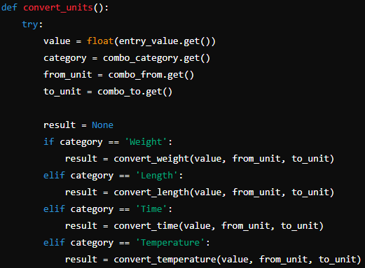
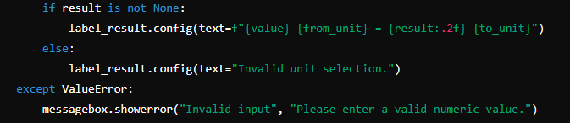
Component (contd….)
Convert_units Function:
Handles the retrieval of input values.
Determines the conversion type based on the selected category.
Calls the appropriate conversion function.
Displays the result in the GUI.
Convert user input from string to a floating-point number.
Catches and displays an error if the input value is invalid (non-numeric).

Slide 7
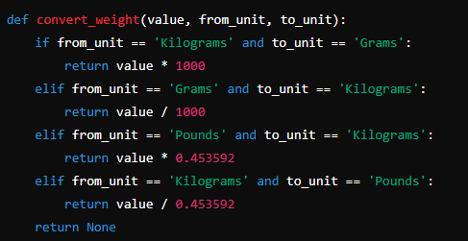
Component (contd…)
convert_weight Function:
Handles conversion between kilograms, grams, and pounds.
Only one if statement executes for one complete execution of program.
It takes three arguments i.e. value; from_unit and to_unit.
Returns the converted value based on the selected units.
Returns ‘None’ if an invalid unit combination is provided.

Slide 8
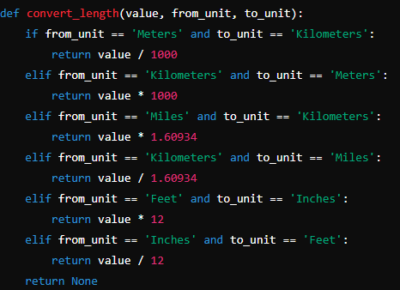
Component (contd…)
convert_length Function:
Converts between length units: Meters, Kilometers, Miles, Feet, Inches.
Returns the converted value based on the selected units.
Returns ‘None’ if an invalid unit combination is provided.

Slide 9
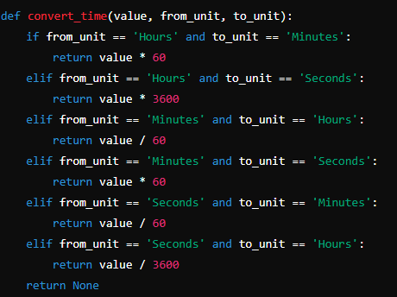
Component (contd….)
convert_time Function:
Converts between time units: hours, minutes, seconds.
Special formatting for results as displays results in hours, minutes, and seconds if converting from seconds to hours.
Returns the converted value based on the selected units.
Returns ‘None’ if an invalid unit combination is provided.

Slide 10
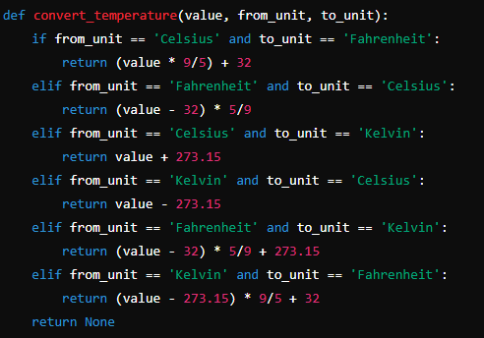
Component (contd….)
convert_temperature Function:
Converts between temperature units: Celsius, Fahrenheit, Kelvin.
Returns the converted value based on the selected units.
Returns ‘None’ if an invalid unit combination is provided.

Slide 11
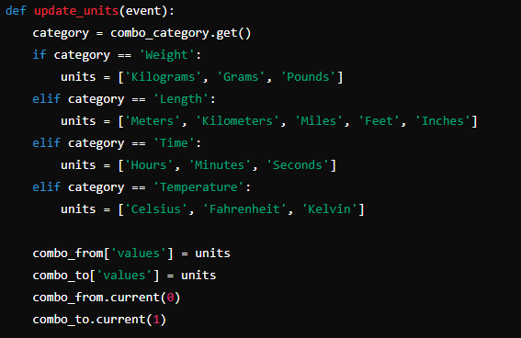
Component (contd….)
update_unit Function:
Updates the available units in the comboboxes based on the selected category.
Determines which units to display based on the selected conversion category (Weight, Length, Time, Temperature).
Sets the default options for the ‘combo_from’ and ‘combo_to’ dropdowns.

Slide 12
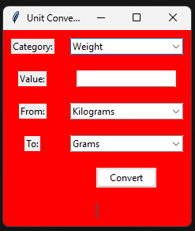
Key Takeways:
Simple yet powerful tool for unit conversion.
Easy-to-use GUI with real-time updates.
Extensible code for adding more categories or units.

Slide 13
DEMO
Live Demonstration:
Showcase how the unit converter works with different categories and units.
Lets go to the ‘Anaconda Prompt’ for code execution to see some real time unit conversion example.

Slide 14


